Slide 1


User Analytics for Strategic
Business Acquisition
In this project, I analyzed telecom user behaviour, network performance, and customer satisfaction to uncover actionable insights for improving the user experience. The dataset, containing over 150,000 records, was thoroughly cleaned by handling duplicates, filling missing values, and addressing extreme values. The data preparation set the stage for detailed analysis, where I explored user engagement, application preferences, and performance metrics like download speeds and retransmission rates.
To provide deeper insights, I used machine learning techniques, including K-Means Clustering for user segmentation and Random Forest Regression to predict satisfaction scores. I saved the trained model using `pickle`, enabling seamless reusability for future predictions. Additionally, I created a visually engaging Streamlit dashboard, providing an interactive interface for stakeholders to explore key findings and visualizations in real-time.
The results were further structured by exporting critical insights and aggregated scores to an SQL Server database. This required configuring the database, defining table structures, and automating data insertion with Python. By combining data engineering, analytics, and predictive modelling with intuitive tools like Streamlit and SQL Server, this project delivered a comprehensive solution for understanding and improving telecom user experience.
by Debasis Baidya

Slide 2


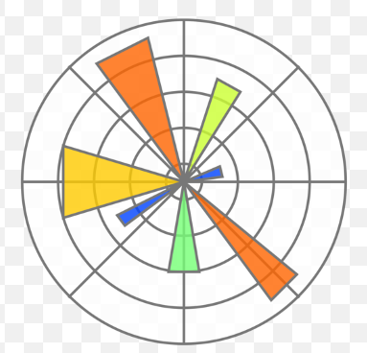





Importing of the necessary Libraries
01
02
03
04
Numpy
Pandas
Matplotlib
Seaborn
It helped me perform numerical computations and handle arrays.
It helped me manipulate and analyze data efficiently.
It helped me create visualizations and plots.
It helped me generate attractive statistical graphics.
05
06
07
08
Scikit-learn
Pickle
SQLAlchemy
Streamlit
It helped me scale features for machine learning.
This module helped me serialize and deserialize Python objects.
It helped me connect to SQL SSMS and execute SQL queries.
It helped me create interactive web applications for model interaction.

Slide 3
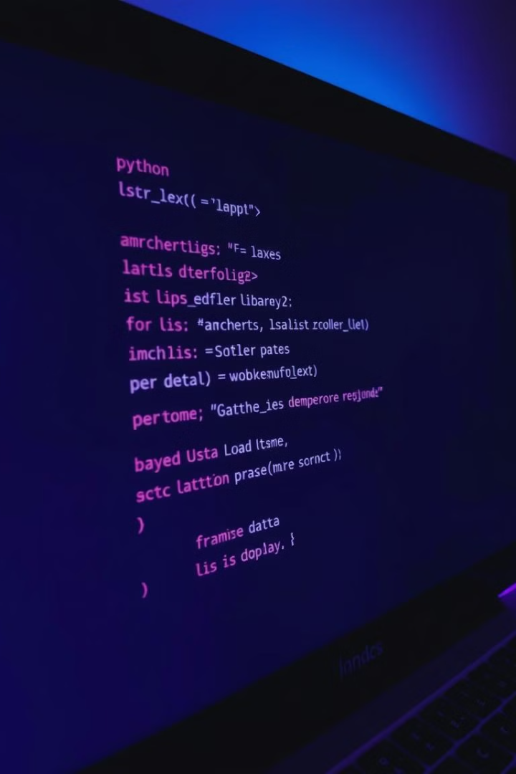
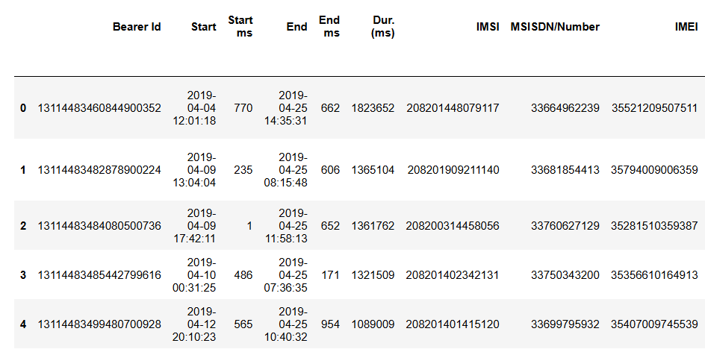
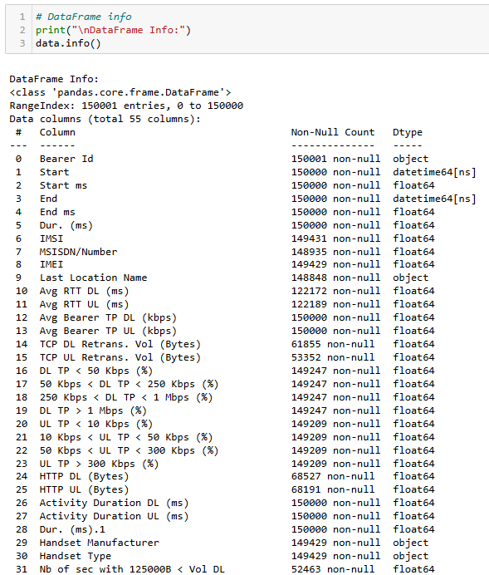
Loading Data & Checking Info
1
Loading Data
Reading the Excel file using pandas i.e.
‘pd.read_excel’
2
Displaying the Max Columns in the DataFrame
Displaying the max columns using pd.set_option('display.max_columns', None) method.
3
Checking Data Information
Using info() to view Column Types, data counts, Data Types.

Slide 4
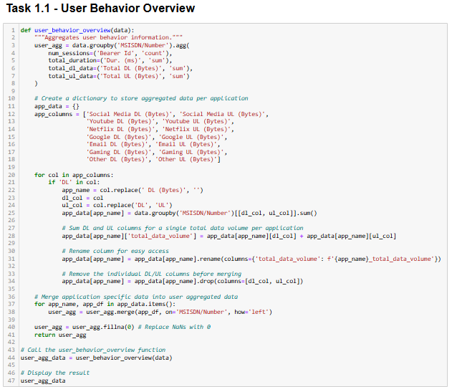
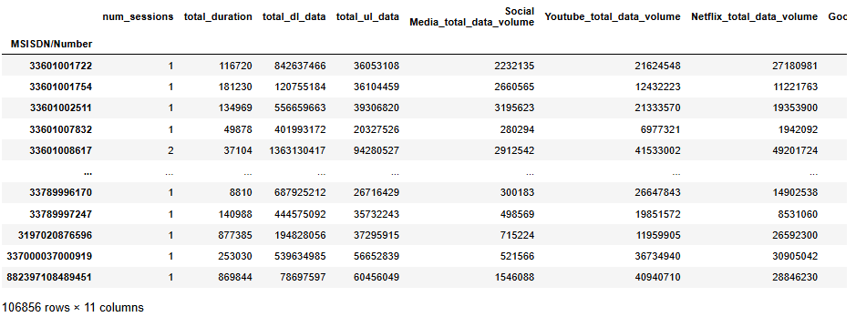
Task 1 - User Overview Analysis
Task 1.1 - User Behaviour Overview
1
Function Creation
Developed a function to aggregate user behaviour data. Generated a
DataFrame (user_agg_data) containing aggregated user metrics, enabling
detailed analysis of user engagement across various applications.
2
Data Aggregation
Grouped by MSISDN/Number to calculate:
Number of Sessions: Count of Bearer Id.
Total Duration: Sum of Dur. (ms).
Total Download Data: Sum of Total DL (Bytes).
Total Upload Data: Sum of Total UL (Bytes).
3
Application-Specific Aggregation
Created a dictionary for applications (e.g., Social Media, YouTube).
Summed download (DL) and upload (UL) data.
Calculated Total Data Volume for each application and merged it into
the main dataset.
Data Cleaning
4
Replaced NaN values with 0 for clarity.

Slide 5
Task 1 - User Overview Analysis
Task 1.2 - Exploratory Data Analysis (EDA)
Data Type Description
Bivariate Analysis
STEP
01
STEP
06
Scatter Plots: Examined relationships (e.g., Social Media vs. total download data) showing positive correlations, indicating increased usage leads to higher data consumption.
Identified data types for each column.
Basic Metrics
Variable Transformations
STEP
02
STEP
07
Generated descriptive statistics.
Segmented session durations into deciles, revealing patterns in data usage.
Missing Values Handling
Correlation Analysis
STEP
03
STEP
08
Created a correlation matrix showing strong relationships (e.g., Social Media and YouTube), useful for targeting marketing strategies.
Filled missing values with mean (numeric) and mode (categorical).
Univariate Analysis
Dimensionality Reduction (PCA)
STEP
04
STEP
09
Calculated dispersion parameters (std, variance, skewness).
Analyzed variance explained by components, indicating key factors in user behaviour.
Graphical Univariate Analysis
Handset Analysis
STEP
05
Histograms: Showed distribution shapes (e.g., right-skewed for total download data), indicating most users have lower download volumes.
STEP
10
Identified top handsets and manufacturers & Successfully saved the cleaned data for future use.
FRE!

Slide 6
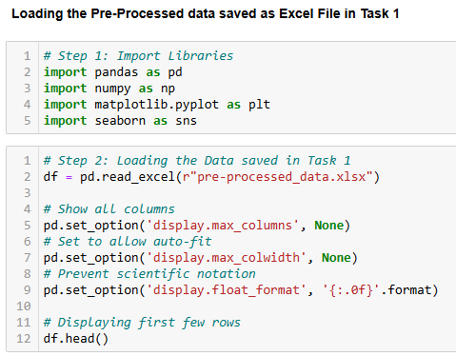
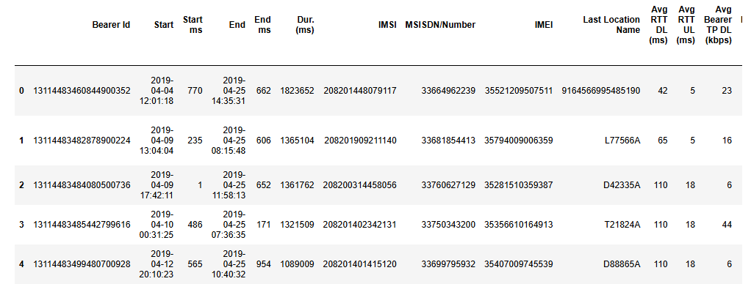
Task 2: User Engagement Analysis
Loading the Data
Used pd.read_excel(r"pre-processed_data.xlsx") to load the dataset.
Data Display Settings
pd.set_option('display.max_columns', None) to show all columns.
pd.set_option('display.max_colwidth', None) for auto-fit.
pd.set_option('display.float_format', '{:.0f}'.format) to prevent scientific notation.
01
02
Initial Data Exploration
Displayed first few rows with df.head().
Checked data types using df.dtypes.
Data Overview
Data Types: Confirmed the structure, including key metrics such as:
Avg Bearer TP DL (kbps): float64
Avg Bearer TP UL (kbps): float64
TCP DL Retrans. Vol (Bytes): float64
03
04

Slide 7
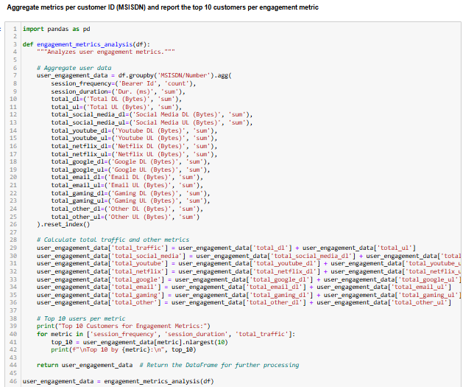
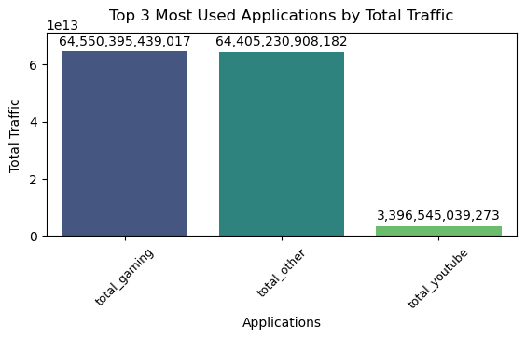
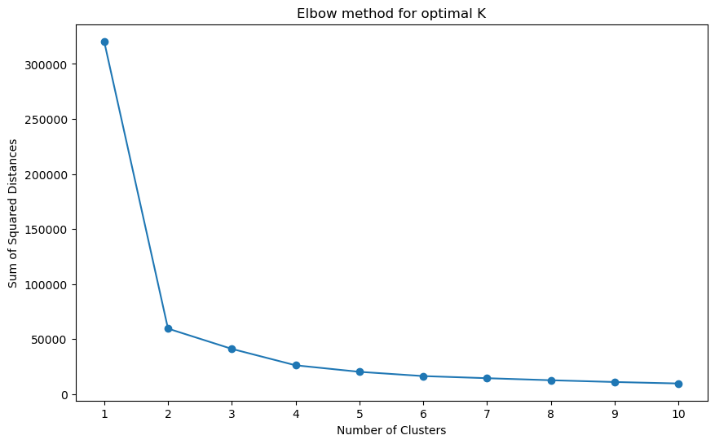
Task 2: User Engagement Analysis
Task 2.1 - Engagement Metrics Analysis
User Groups I grouped users into three categories based on how they use the platform:
Low Engagement: Some users hardly use the platform.
Highly Engaged: A small group of users is very active, with up to 1066 sessions.
Moderate Engagement: Most users fall somewhere in between.
01
Traffic by Application I looked at how much data different applications use and found:
Gaming: This app uses about 64 trillion bytes of data.
Other Applications: Also around 64 trillion bytes.
YouTube: This one uses about 3.4 trillion bytes.
02
Most Used Applications The top three applications that users engage with the most are:
Total Gaming
Total Other
Total YouTube
Gaming is clearly the favourite among users.
03
04
Optimal Clusters To figure out how many user groups to create, I used a method called the elbow method. It showed that three groups make the most sense, as there’s not much difference when trying to add more groups.
Graphical Insights Engagement Clusters - Scatter Plot: I created a scatter plot that shows how total session time relates to total data usage. It clearly shows the three user groups I identified.
Top Applications - Bar Chart: I made a bar chart that displays the total data used by the most popular applications. It highlights how much more gaming and other applications are used compared to YouTube.
Elbow Method - Line Graph: I used a line graph to show the sum of squared distances for different numbers of user groups. It visually confirms that three groups is the best choice.
05

Slide 8



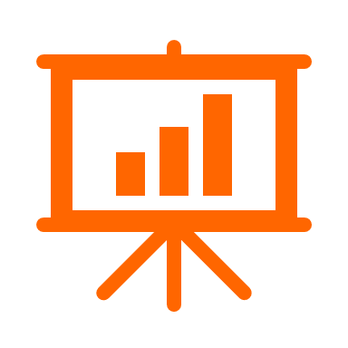




Task 3: Experience Analytics
Task 3.1 - Aggregate Experience Metrics | Task 3.2 - Top and Bottom Metrics | Task 3.3 - Distribution Analysis | Task 3.4 - Clustering User Experiences
Cleaned the Data
Combined Data
01
Fixed missing information by filling in gaps with average values for numbers and the most common type for names.
Found and limited extreme values to keep the data accurate.
02
Grouped information by customer to get average performance metrics like data retransmission and speed.
Analyzed Metrics
Created Visuals
03
Looked at the best and worst performance numbers, as well as the most common values.
04
Made bar charts to show average speeds and data retransmission for the top 10 phone types, making it easier to see differences.
05
Grouped Users
06
Saved the Data
Used a simple method to categorize users based on their performance metrics, helping to identify different user experiences.
Exported the cleaned and combined data into CSV files for future use.
Average Throughput Graphical Insights
Average TCP Retransmission Insights
07
Top Performer: Huawei B715S-23C: 89,088.18
General Range: Most handsets around 80,000.
Low Performers: Several models (e.g., Spa Condor) near 60,000.
08
Highest: Huawei B715S-23C: 53,486,938.00
High Counts: Other models (Huawei Pele, Y9 2019)
also show significant retransmissions.
Lowest: Zyxel Communicat. Sbg3600: 44,508.00.

Slide 9
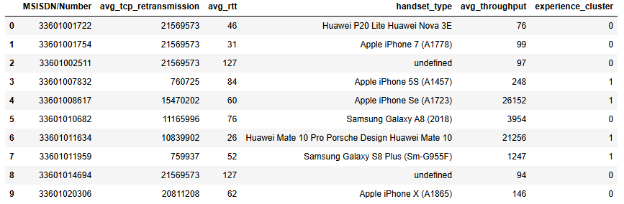
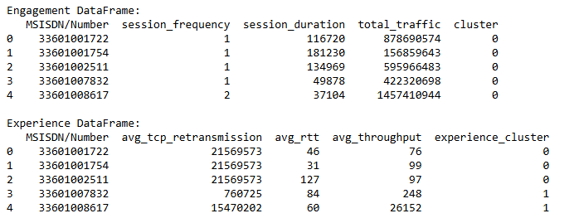
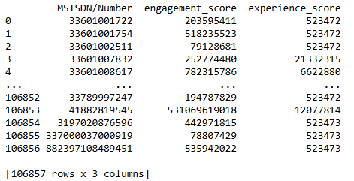
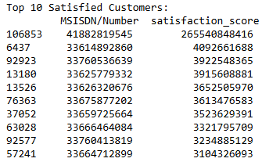
Task 4: Satisfaction Analysis
Task 4.1 - Assign Scores | Task 4.2 - Satisfaction Score
Data Preparation
Created df_engagement: Extracted relevant columns from the engagement data.
Created df_experience: Extracted relevant columns from the experience data.
Function Definition
Defined assign_scores Function
Identified Clusters
Calculated Averages
Assigned Scores
Merged Scores
Function Execution
Called assign_scores and printed the resulting DataFrame, handling any errors that occurred.
Error Handling: Included error handling to catch and print any issues during execution.
Calculating Satisfaction Score
Added a new column, satisfaction_score, using the formula: satisfaction_score = (engagement_score + experience_score) / 2
Identifying Top Customers
Extracted the top 10 customers with the highest satisfaction scores.

Slide 10
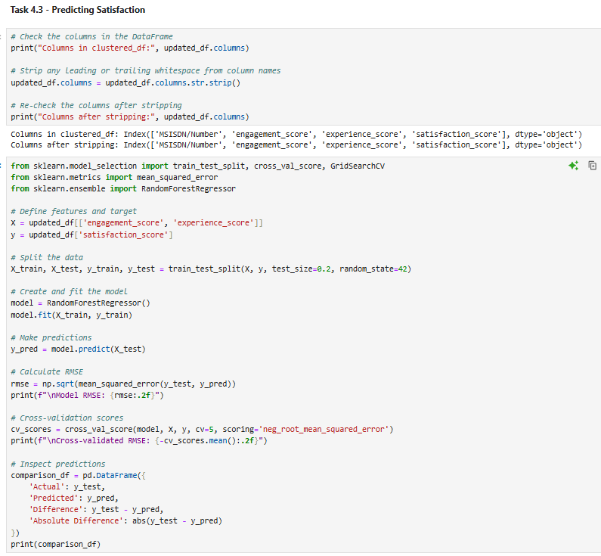
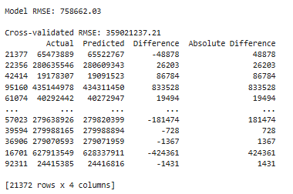
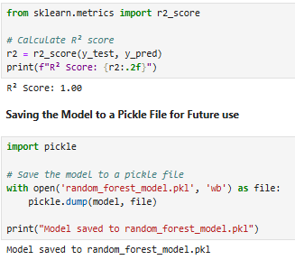
Task 4: Satisfaction Analysis
Task 4.3 - Predicting Satisfaction
Data Preparation
Checked and stripped whitespace from the DataFrame column names.
01
Feature and Target Definition
Defined features (X) as engagement_score & experience_score.
Defined the target variable (y) as satisfaction_score.
02
Data Splitting
Split the data into training and testing sets (80% train, 20% test).
03
Model Creation and Training
Created a Random Forest Regressor model and fitted it to the training data.
04
Predictions
Made predictions on the test set.
Model RMSE: 758,662.03 | Cross-Validated RMSE: 359,021,237.21
05
Model Evaluation
Calculated RMSE, Cross-validated through positive branding.
Generated a comparison DataFrame of actual vs. predicted values.
06
R² Score Calculation
Calculated the R² score to assess the model's performance.
R² Score: 1.00 (indicating perfect fit)
07
Model Saving
Saved the trained model to a pickle file for future use.
08

Slide 11
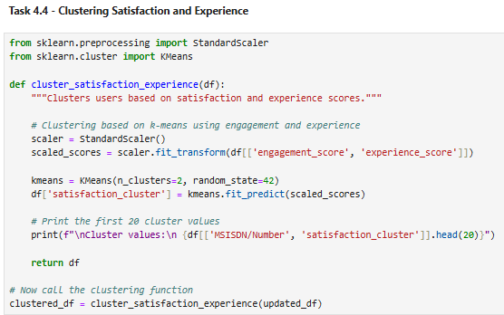
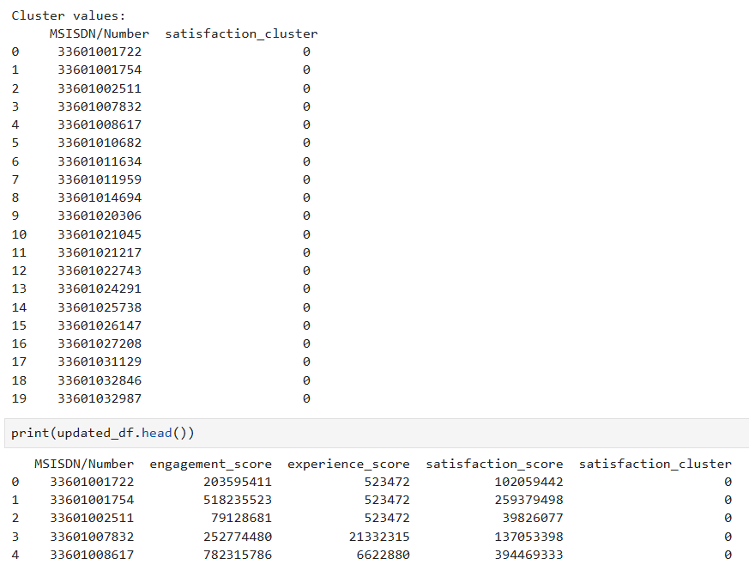
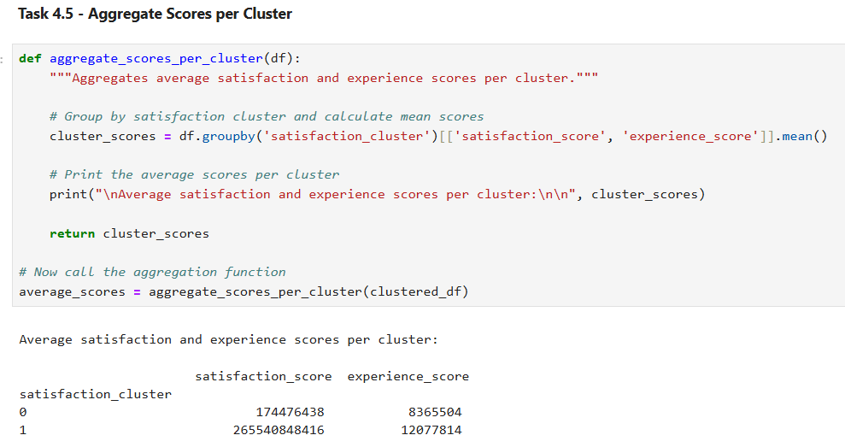
Task 4: Satisfaction Analysis
Task 4.4 - Clustering Satisfaction and Experience | Task 4.5 - Aggregate Scores per Cluster
Data Standardization
Used StandardScaler to normalize the engagement_score and experience_score for better accuracy.
K-Means Application
Implemented K-Means with 2 clusters to categorize users.
Function Creation
Developed a function to perform clustering.
Function Development
Created a function to aggregate scores by cluster.
Aggregation
Used groupby to calculate the mean satisfaction and experience scores for each cluster.

Slide 12
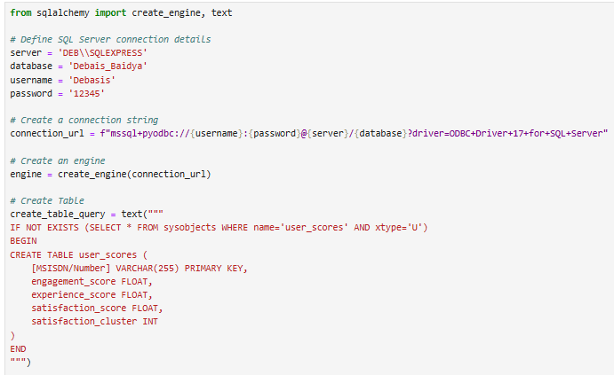
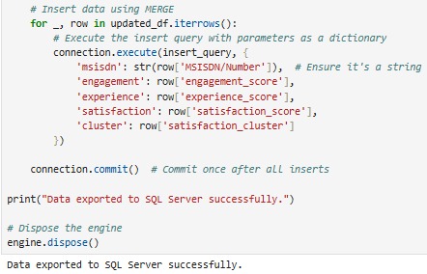
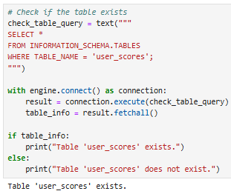
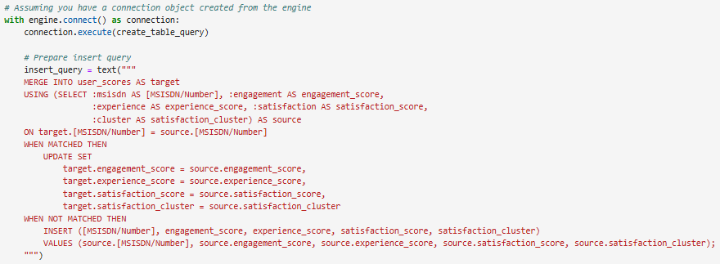
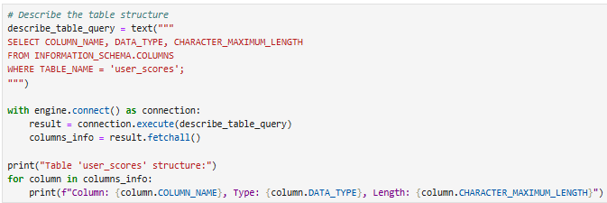
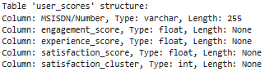
Task 4: Satisfaction Analysis
Task 4.6 - Export to MySQL
01
Install Required Libraries
Utilized sqlalchemy and pyodbc for database connectivity.
02
Connection Setup
Defined connection details for SQL Server and created a connection string.
03
Table Creation
Executed a query to create the user_scores table, checked if it did not already exist.
04
Data Insertion
Used a MERGE statement to insert or update user scores based on the existing records in the table.
04
user_scores table in SQL Server
Successfully exported data to SQL Server.
04
Verified Table Existence
Confirmed that the user_scores table exists.
04
Table Structure
Retrieved and displayed the column names, data types, and lengths, ensuring the table structure is as expected.

Slide 13
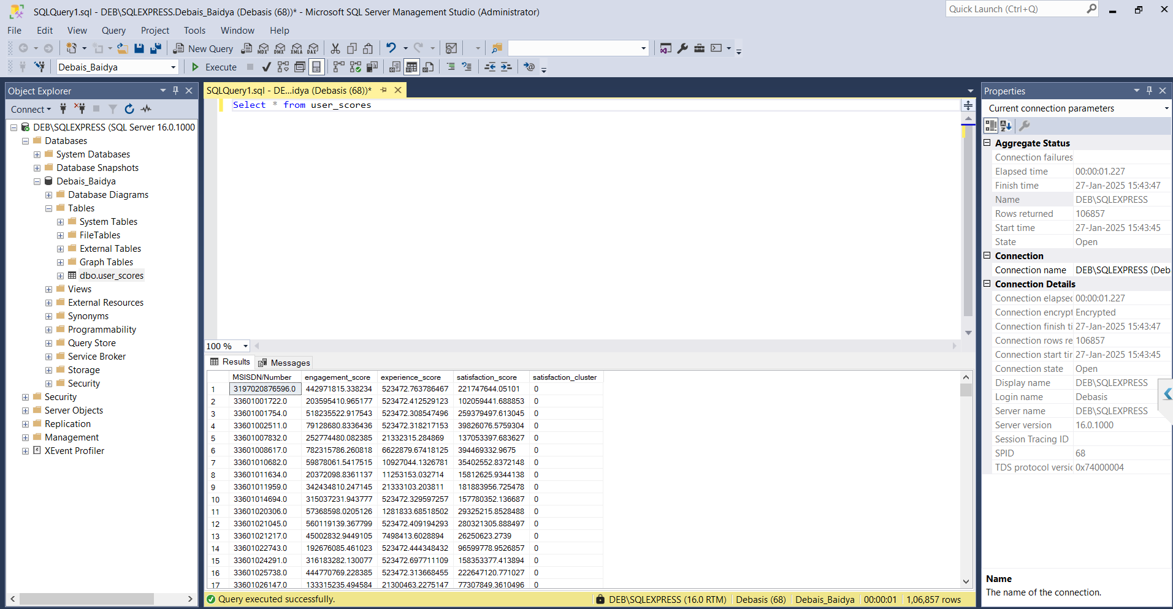
1
Executed Query in SQL SSMS
2
Results Appeared in Output Pane
Executed “Select * from user_scores” table to check if it populates correctly.
Data in ‘users_scores’ table appeared with All the columns present in updated_df DataFrame

Slide 14
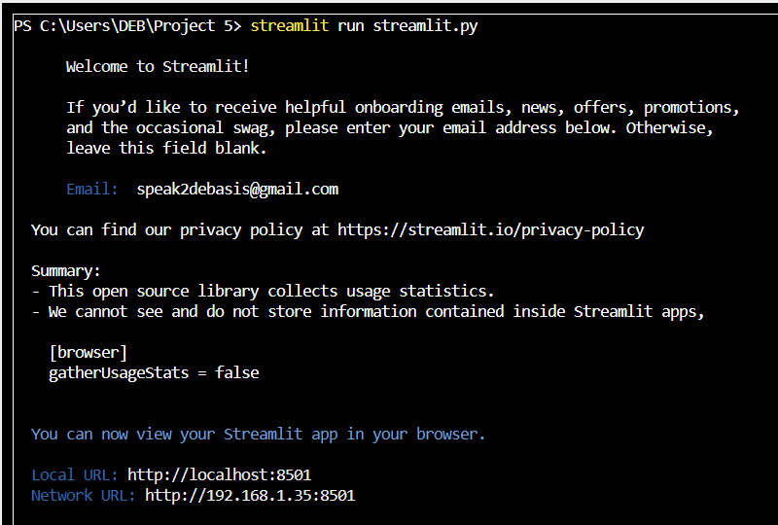
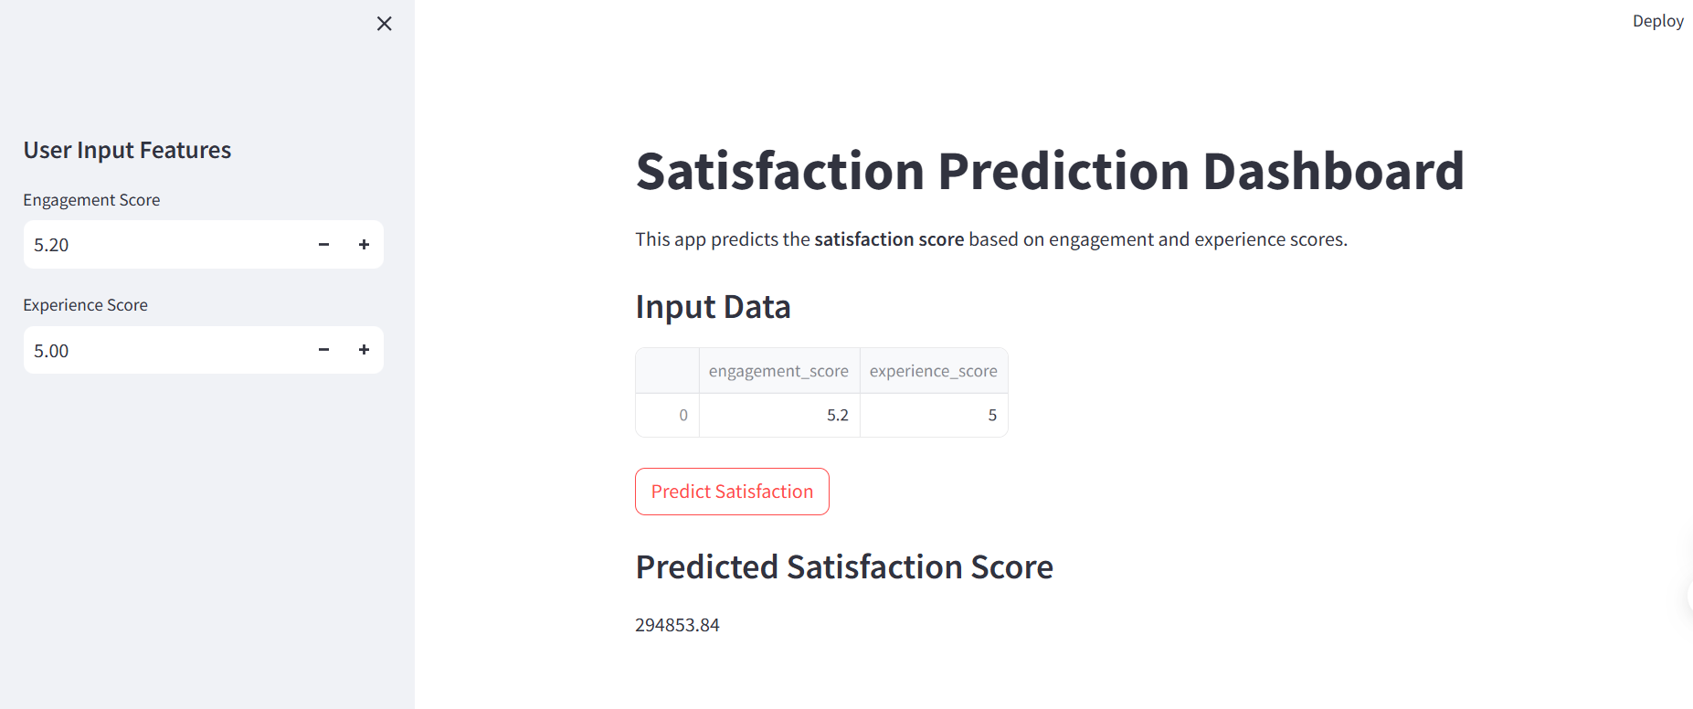
Streamlit Setting Up & App Testing
Streamlit.py File Execution with Pickle
1
Used Pickle module to load the model
random_forest_model.pkl & set it up for
Streamlit Satisfaction Prediction Dashboard
Executed Streamlit Run Command from Terminal
1
First copied path of my python file & then entered
cd “C\Users\DEB\Project 5” to open the directory &
Executed the ‘steamlit run streamlit.py’ in terminal window.
2
Local & Network URL to view Streamlit App
Got Local URL: http://localhost:8501 &
Network URL: http://192.168.1.35:8501 to go to Streamlit
App in Web Browser.
3
User Input & Predict Satisfaction Button Checked
Gave 5.20 as ‘Engagement Score’ & 5.00 as Experience
Score & pressed the button Predict Satisfaction to check
the ‘Predicted Satisfaction Score’.

Slide 15


Summary
Future Enhancements
Q&A
I hope you found this presentation helpful and informative.
Please don't hesitate to contact me with any questions or feedback you may have.
I am more than eager to hear your thoughts and suggestions.

